Slide 1

NFL Point Spread Prediction
Daniel Fox
Wen Chiang Ivan Lim
Kevin Metzler
Duy Pham

Slide 2
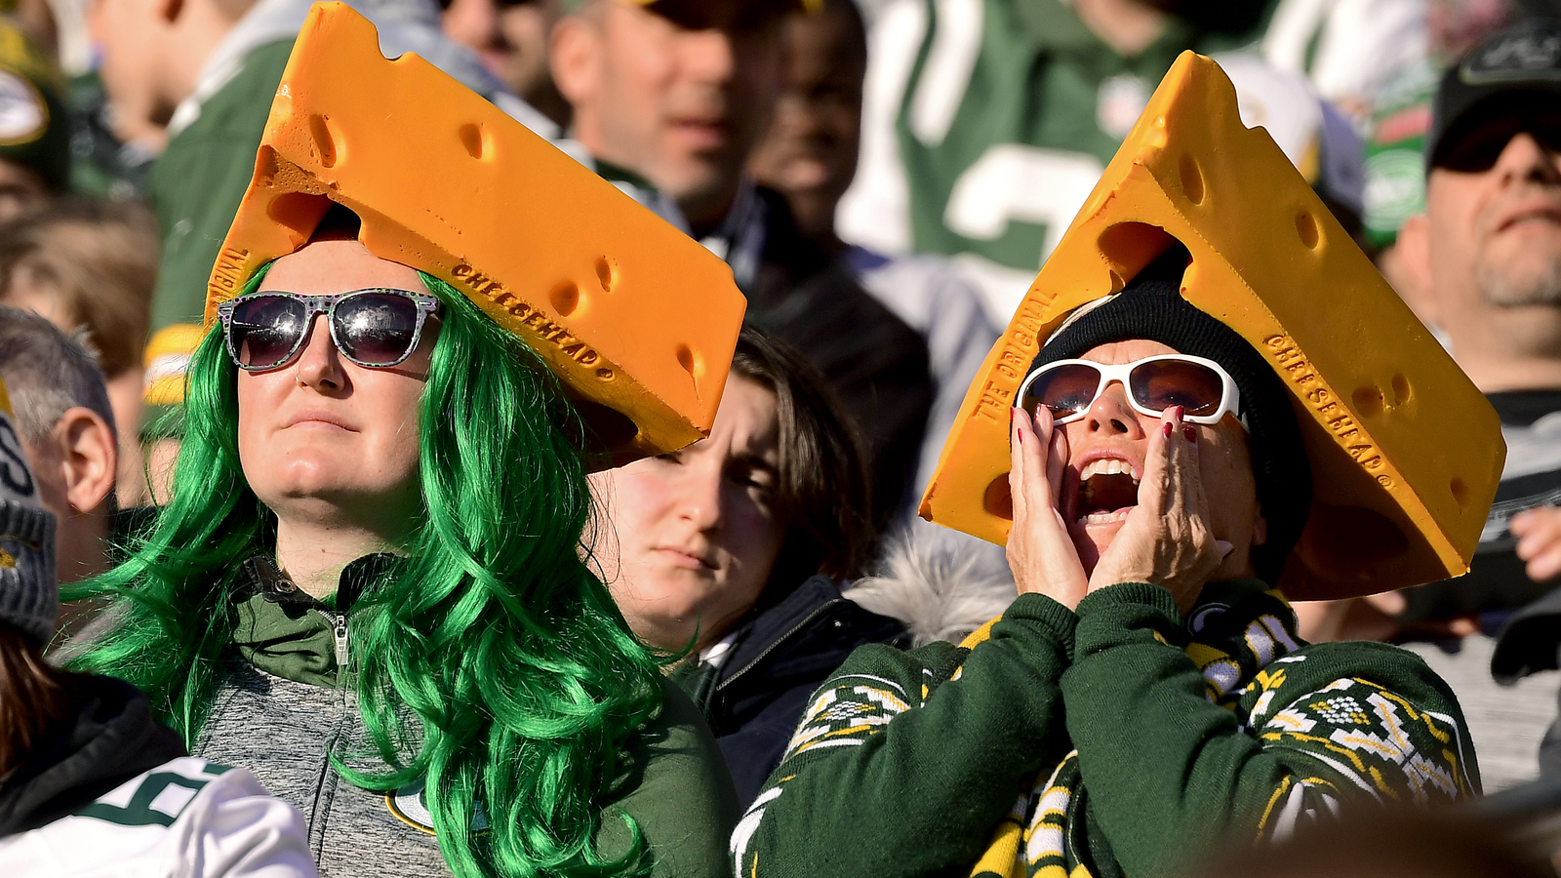


Problem Description
Predict the gap in the Final Scores.
Motivations:
Sports Betting.
Team Leadership.
Football Fans.

Slide 3
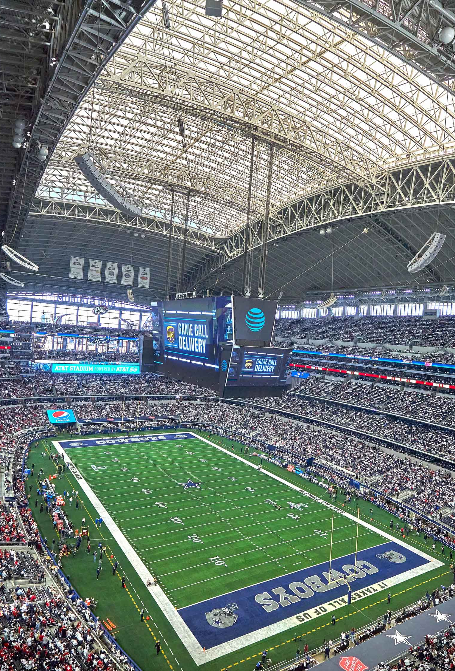
Dataset Description
Scraped and collected online.
8,300 games between 1991 to 2022.
147 variables from three categories (scores, environmental, game statistics)
Preprocessing:
Sensible data imputation (e.g., 0 wind speed for game within domes)
Attendance data for covid games
Hot encoding teams for home and away
Notes:
From 12,829 games between 1970 to 2022
Variables belong to three categories:
Scores: Scores by game, quarters, & overtime and point spread.
Environmental: Stadium or dome, temperature, wind speed, & humidity.
Game Statistics: Passing yards, rushing yards, turnovers, & penalties.

Slide 4
Two Perspectives
We approached the problem on prediction of score point differences from two perspectives
In-game prediction of final score gap based on game statistics, and environmental factors
Future game prediction of final score gap based on past game statistics
Due in part to the need for understanding of the features that matter to the results of a game and more importantly, the appreciation for the challenge and difficulty in predicting future games.

Slide 5
We tried the following methods for in-game prediction. Which did you think worked best? In terms of test R2 and test MSE...
Lasso regression
Ridge regression
Regression Tree
Full model linear regression
Removal of outliers before fitting full model linear regression
Random Forest
Model Tree
(hybrid of regression tree and linear regression)
Transformation methods

Slide 6
We tried the following methods for in-game prediction. Which did you think worked best?
Method | Test R2 | Test MSE
Full model linear regression | 0.8832599 | 24.52052
Random Forest (Max Depth = 10) | 0.7640823 | 49.62753
Lasso | 0.6252612 | 78.80247
Lasso (tuned) | 0.8832190 | 26.45348
Ridge (tuned) | 0.8829164 | 26.52203
Model tree (tuned) | 0.8817807 | 26.77928
Full model linear regression after removal of outliers | 0.8826767 | 26.57632
PCA on Linear Regression | 0.6041471 | 83.22631
Y:= Y+2*(Y)^(1/3) Transformation | 0.8855100* | 39.22493*
Sigmoid Transformation | 0.8695056* | 98.44117*

Slide 7
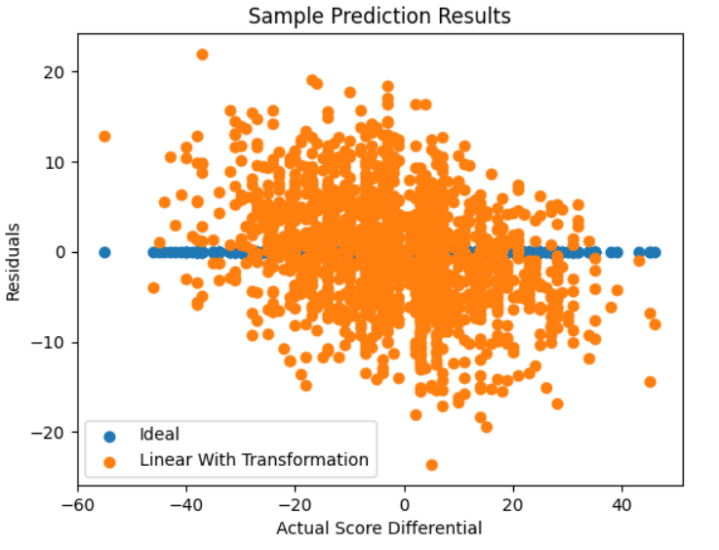
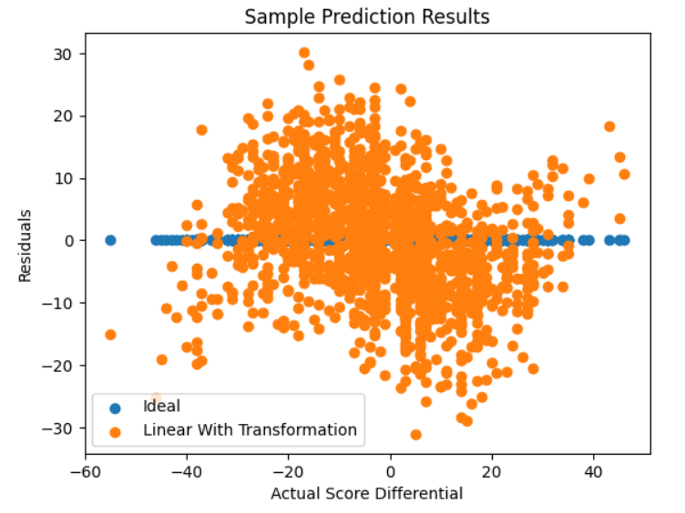
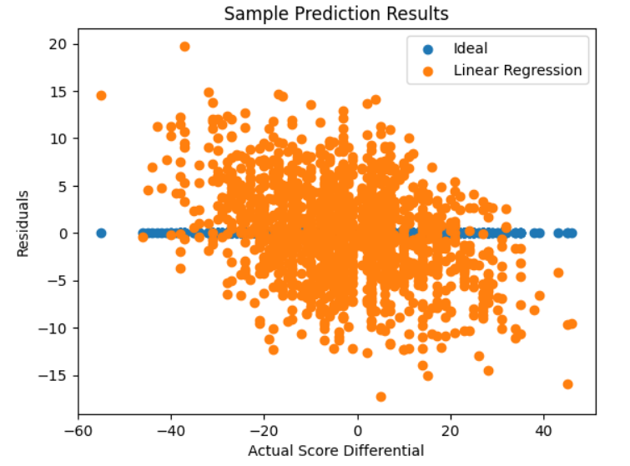
Several Residual Plots
Cube Root Transformation
Sigmoid Transformation
Full Model Linear Regression

Slide 8
We tried the following methods for in-game prediction. Which did you think worked best?
Best approach: Full model linear regression
Full model too long, so some of the interesting coefficients are discussed below.
Most Influential Features | Coefficient
Home Passing TDs | -3.319
Home Rushing TDs | -3.168
Ravens at Home | -1.673
Visiting Turnovers | -1.528
Patriots at Home | -1.438
Game on Friday | -1.258
Game on Tuesday | -1.176
Field made of Desso Grass | -1.148
Packers at Home | -1.076
Most Influential Features | Coefficient
Visiting Rushing TDs | 3.024
Visiting Passing TDs | 2.985
Home Turnovers | 1.503
Patriots Visiting | 1.486
Saints at Home | 1.037
Least Influential Features | Coefficient
Visitor Passing Yards | -0.0058
Week of the Season | -0.0051
Home Possession Time | -0.0014
Home Rushing Yards | -0.0005
Temperature | -0.0004
Attendance | -0
Game on Wednesday | 0
Visitor Time of Possession | 0.0007
Visitor Rushing Yards | 0.0013
Wind Chill | 0.0018
Year | 0.0085
Intercept | -22.030

Slide 9
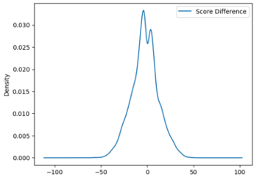
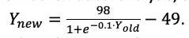
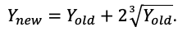
Discussion of other methods
Transformations tried to address poorer performance at
edges of score distribution:
Dropping of influential outliers before fitting linear regression
Cook's distance > 4/number of data points
Model Tree
Depth 9 and 10 returned single leaf nodes with linear regression, suggesting returns from model tree is marginal.
Depth 11 returned much more complex leaf nodes but had poorer performance

Slide 10
Future-game prediction pre-processing
Hyperparameters.
N = Number of games
W = Season weighting
S = Rows for early games eliminated
Average point differential, visitor minus home
32 variables of previous opponents played against by both teams.
Weighted for previous seasons

Slide 11
Cross Validation For Time Series
Problem: The data is no longer I.I.D.
Later observations might indicate past trends.
Essentially cheating.
Solution: Incremental Cross-Validation!
Split the data into K-Folds as usual.
Train with the 1st, and test on the 2nd.
Train with the 1st and the 2nd, and test on the 3rd.
Rinse and repeat!

Slide 12
Cross Validation For Time Series
Partition 0: Seasons 1993 through 1996
Partition 1: Seasons 1997 through 2000
Partition 2: Seasons 2001 through 2004
Partition 3: Seasons 2005 through 2008
Partition 4: Seasons 2009 through 2012
Partition 5: Seasons 2013 through 2016

Slide 13
Cross-Validation Results & Hyper-tuning
Method | Hyper Parameters | Parameters | MAE CV Mean
Random forest | N=41, W=0.2, S=5 | max_depth=3, n_estimators=100 | 10.526
Support vector regressor | N=41, W=0.2, S=5 | defaults | 10.605
Ridge | N=32, W=0.3, S=5 | alpha=10, tol=0.00001 | 10.625
Linear regression | N=28, W=0.3, S=5 | Defaults | 10.632
K-nearest neighbors | N=36, W=0.2, S=5 | n_neighbors=15, p=1 | 10.846

Slide 14
Test Results
Method | Test MAE | Test RMSE
Vegas Odds | 9.97 | 13.28
Linear Regression | 10.30 | 13.29
Ridge | 10.33 | 13.32
538 ELO | 10.33 | 13.33
Random Forest | 10.37 | 13.28
Support Vector Machine (SVM) | 10.43 | 13.44
K-Nearest Neighbors (KNN) | 11.12 | 14.17

Slide 15
Speculative Gambling strategy?
Method | No. Games Bet (over 6 seasons) | Accuracy | ROI
Random Forest | 93 | 0.5914 | 10.57%
Support Vector Regressor | 173 | 0.5491 | 2.66%
Ridge | 130 | 0.5462 | 2.11%
Linear Regression | 122 | 0.5410 | 1.14%
K-Nearest Neighbors | 407 | 0.5405 | 1.06%

Slide 16
Conclusion
Future game prediction is much harder than in-game prediction. If the objective is to learn what is important in winning games, it is easier. A lot of things change between the games, and the data shows none of that.
But if the objective is beating odds, it is much more difficult considering the information asymmetry with Vegas betting.

Slide 17
Thank You!
Thanks to Professor Toru for his tips and insights.
Thank you for listening!
Questions?

